Slide 1
Fake News vs. Satire
A Dataset and Analysis
2019-04-17
CS795/895
Puneeth Bikkasandra
Old Dominion University

Slide 2
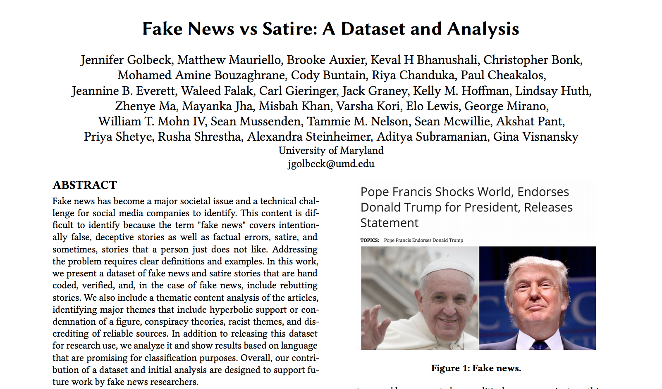
http://web.stanford.edu/~mattm401/docs/2018-Golbeck-WebSci-FakeNewsVsSatire.pdf

Slide 3
Fake News:
“Fake news is information, presented as a news story that is factually incorrect and designed to deceive the consumer into believing it is true.”
Satire:
“Presents stories as news that are factually incorrect, but the intent is not to deceive but rather to call out, ridicule, or expose behavior that is shameful, corrupt, or otherwise bad.”
http://web.stanford.edu/~mattm401/docs/2018-Golbeck-WebSci-FakeNewsVsSatire.pdf

Slide 4
Description of Data Set:
Manually crafted.
283 fake news stories.
203 satirical stories.
American Politics.
Period: Jan 2016 - Oct 2017.
URL: Fake news and article rebutting it.
http://web.stanford.edu/~mattm401/docs/2018-Golbeck-WebSci-FakeNewsVsSatire.pdf

Slide 5
Target Questions:
Question 1:
“Are there differences in the language of fake news and satirical articles on the same topic such that a word-based classification approach can be successful?”
Question 2:
“Are there substantial thematic differences between fake news and satirical articles on the same topic?”
http://web.stanford.edu/~mattm401/docs/2018-Golbeck-WebSci-FakeNewsVsSatire.pdf

Slide 6
Guidelines for Data Set Extraction:
American Politics:
1.1 Not limited, ensuring the consistency of topics.
1.2 Topical difference not affecting the classifier.
Recent Articles:
2.1 Ensuring topics discussed in the articles are similar.
Diverse Sources:
3.1 Selected articles from diverse sources.
3.2 5 articles from a source (website).
No Borderline cases.
Inter-rater agreement: Cohen’s kappa was 0.686 with an accuracy of 84.3%.
http://web.stanford.edu/~mattm401/docs/2018-Golbeck-WebSci-FakeNewsVsSatire.pdf

Slide 7
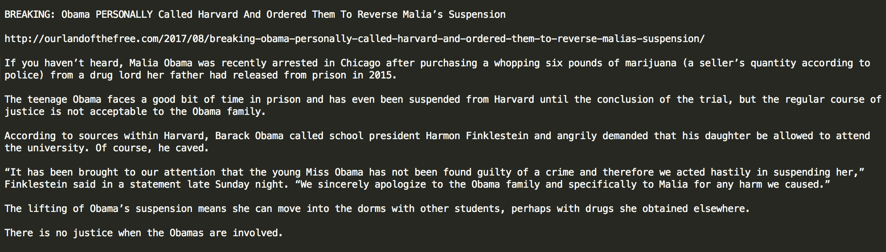
Example: Fake News Article In Data Set:
TITLE
URL
CONTENT
https://github.com/jgolbeck/fakenews
http://web.stanford.edu/~mattm401/docs/2018-Golbeck-WebSci-FakeNewsVsSatire.pdf

Slide 8
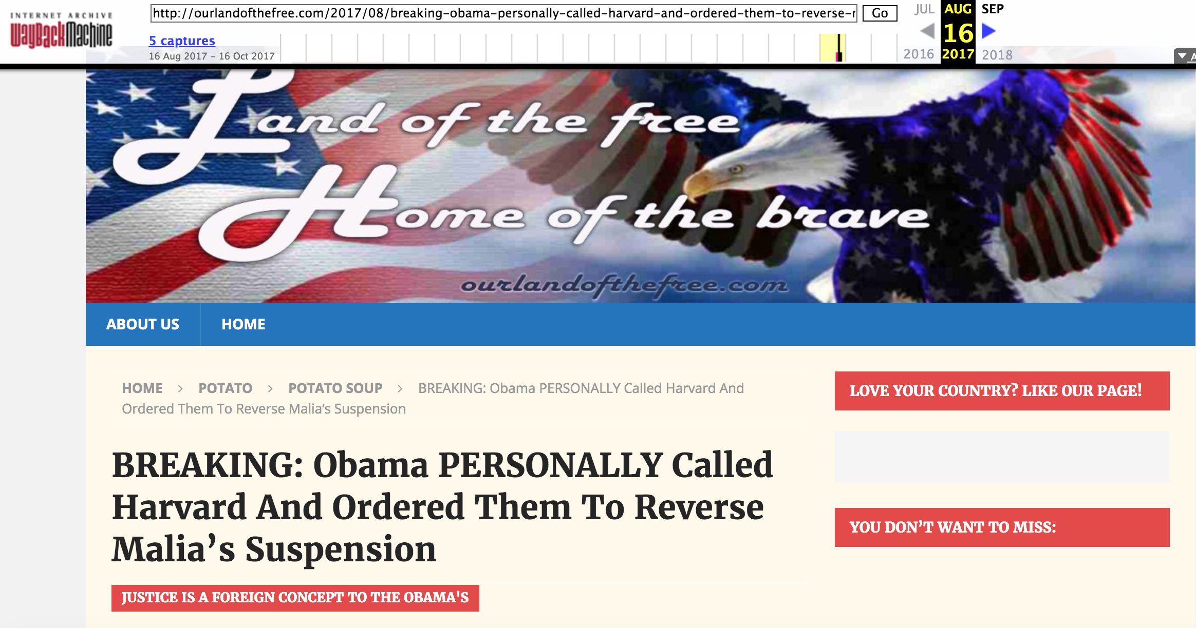
Archived.
https://web.archive.org/web/20170816172900/http://ourlandofthefree.com/2017/08/breaking-obama-personally-called-harvard-and-ordered-them-to-reverse-malias-suspension/

Slide 9
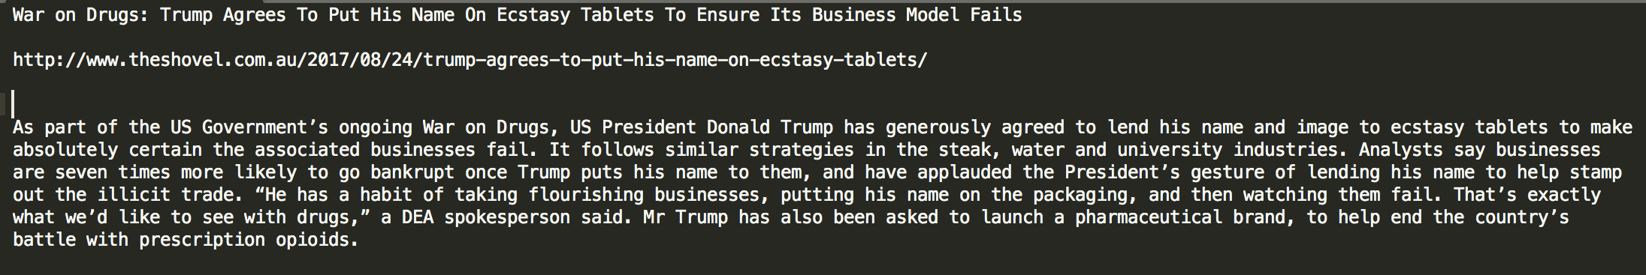
Example: Satire Article In Data Set:
TITLE URL CONTENT
https://github.com/jgolbeck/fakenews
http://web.stanford.edu/~mattm401/docs/2018-Golbeck-WebSci-FakeNewsVsSatire.

Slide 10
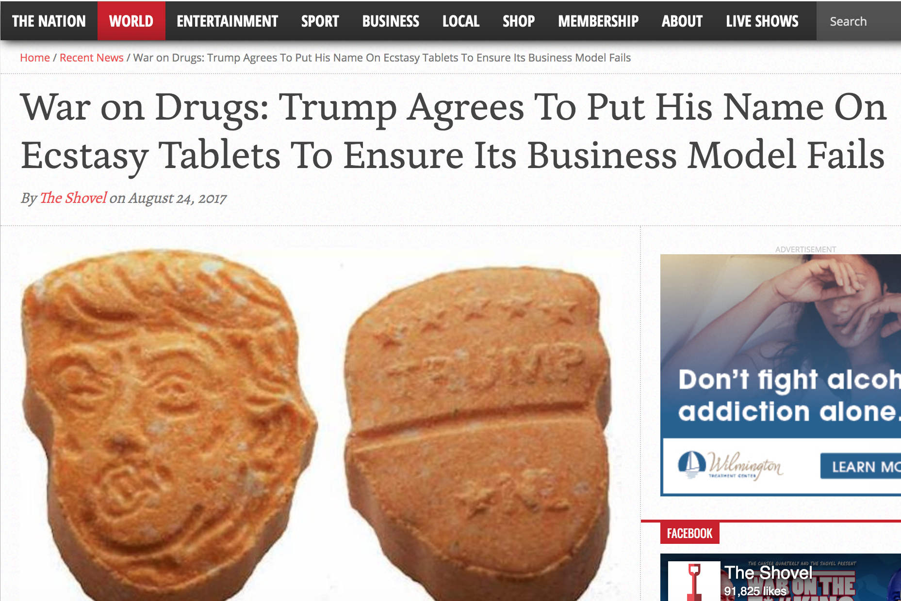
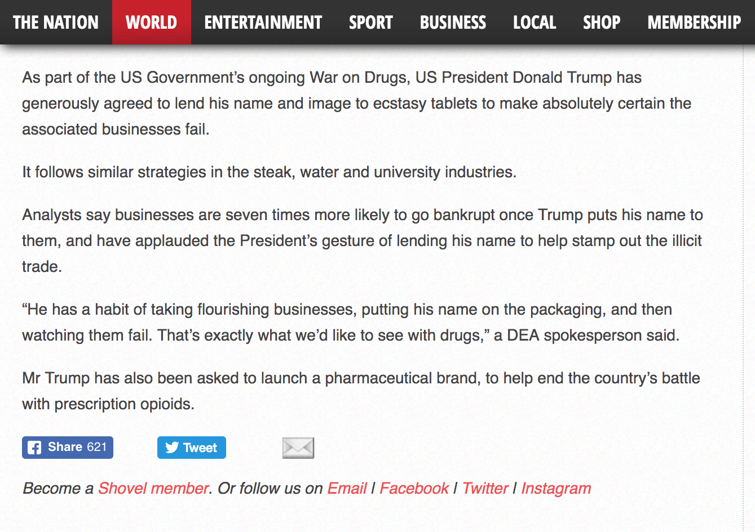
Example Satire Content:
http://www.theshovel.com.au/2017/08/24/trump-agrees-to-put-his-name-on-ecstasy-tablets/

Slide 11
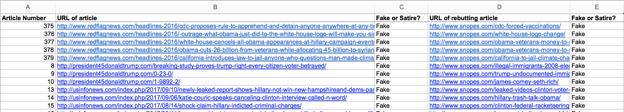
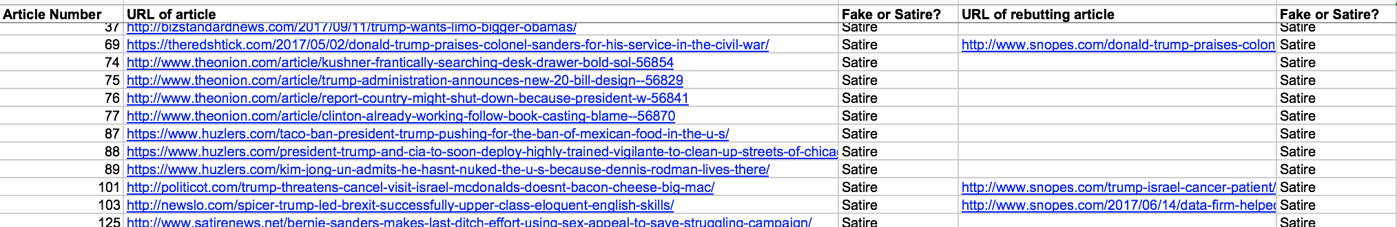
Fake News Story Template:
Satire Template:
https://github.com/jgolbeck/fakenews
http://web.stanford.edu/~mattm401/docs/2018-Golbeck-WebSci-FakeNewsVsSatire.pdf

Slide 12
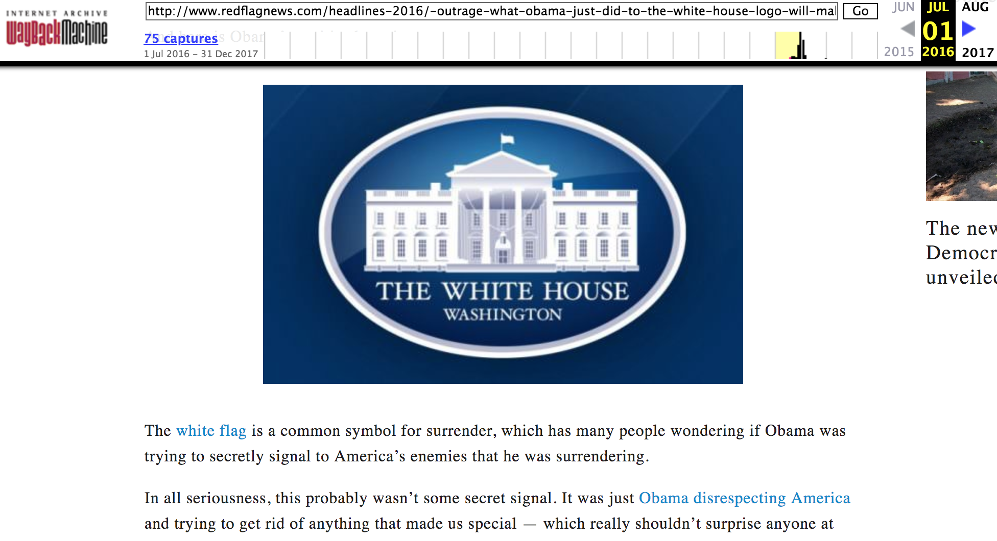
Fake News Story:
https://web.archive.org/web/20160701233111/http://www.redflagnews.com/headlines-2016/-outrage-what-obama-just-did-to-the-white-house-logo-will-make-you-sick

Slide 13
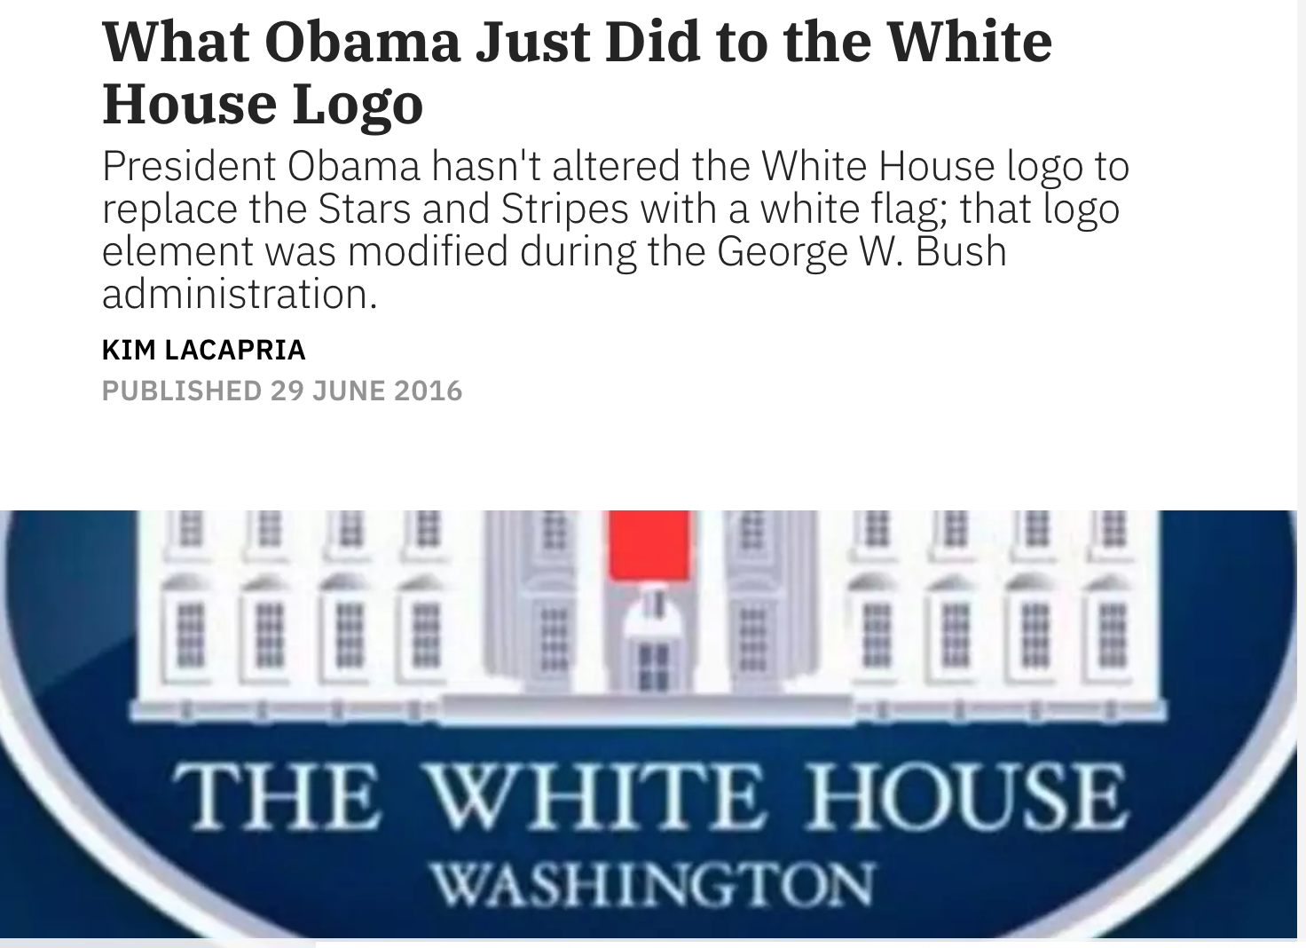
Rebutting Article:
https://www.snopes.com/fact-check/white-house-logo-change/

Slide 14
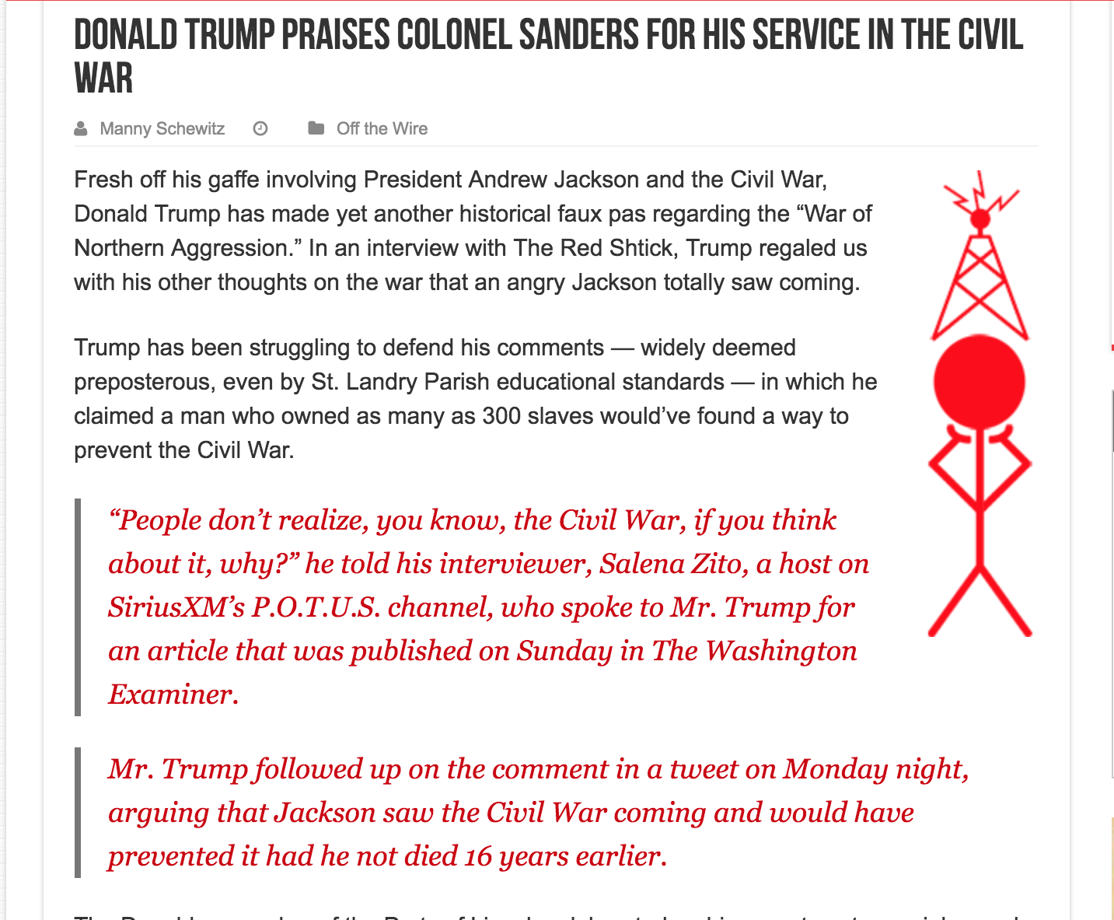
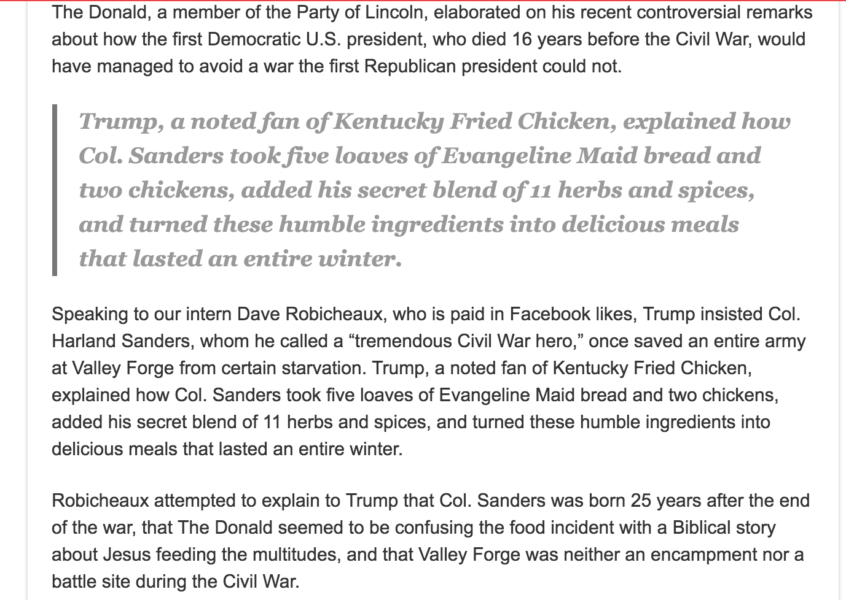
Satire Article:
https://theredshtick.com/2017/05/02/donald-trump-praises-colonel-sanders-for-his-service-in-the-civil-war/

Slide 15
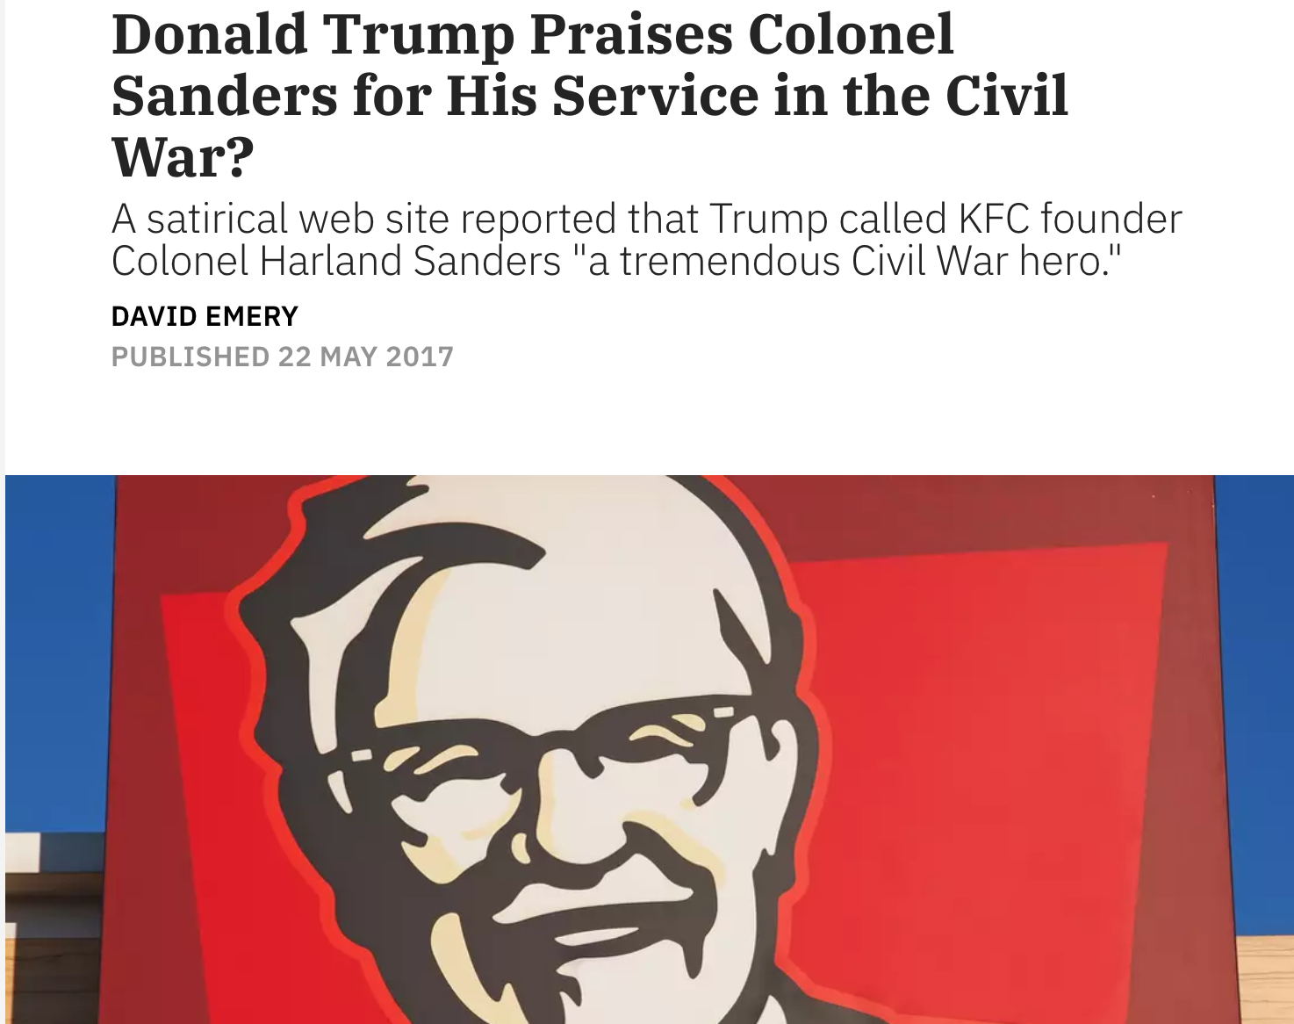
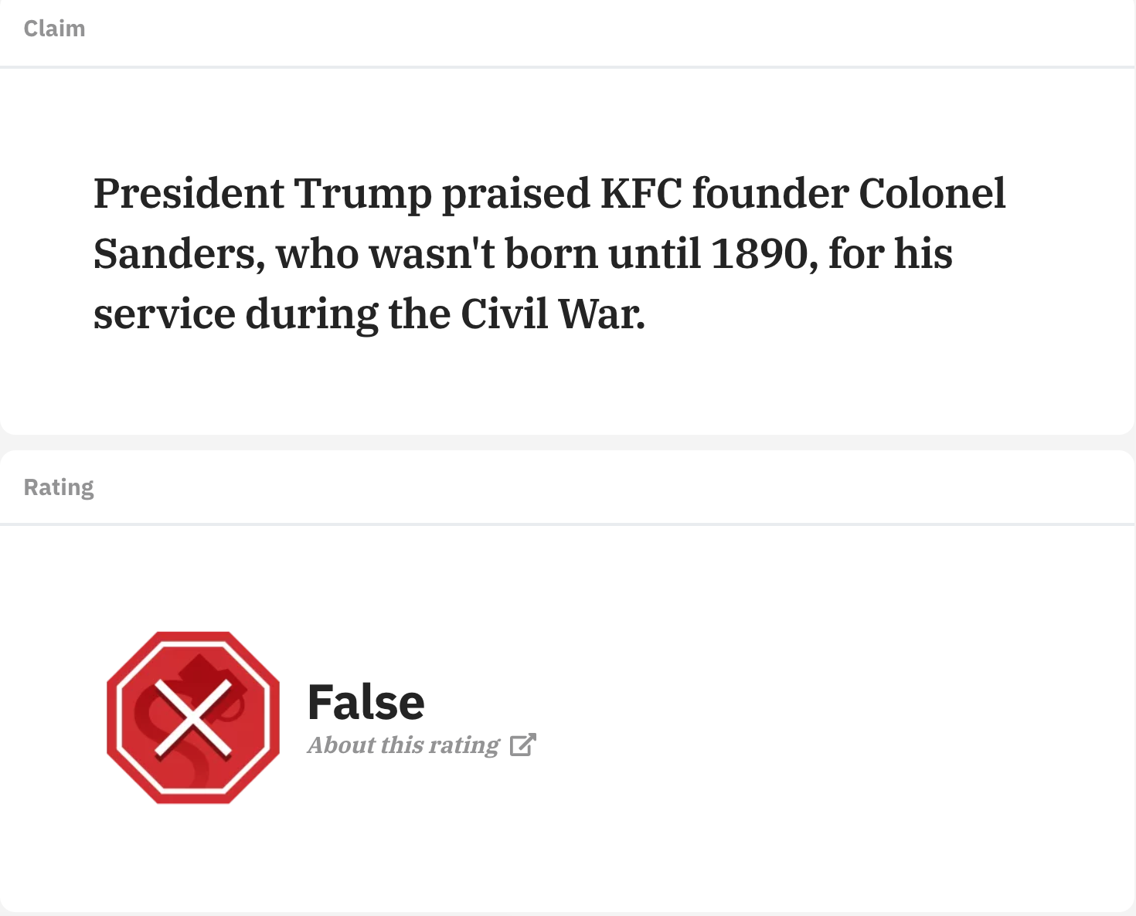
Supporting Article:
https://www.snopes.com/fact-check/donald-trump-praises-colonel-sanders/

Slide 16
Classification:
Targeting Research Question:
“Are there differences in the language of fake news and satirical articles on the same topic such that a word-based classification approach can be successful?”
Each article represented as word-vector, class - Fake/Satire.
Trained using “Naive Bayes Multinomial Algorithm”.
Tested - 10 fold Cross Validation.
Accuracy - 78% ; ROC AUC - 0.876.
http://web.stanford.edu/~mattm401/docs/2018-Golbeck-WebSci-FakeNewsVsSatire.pdf

Slide 17
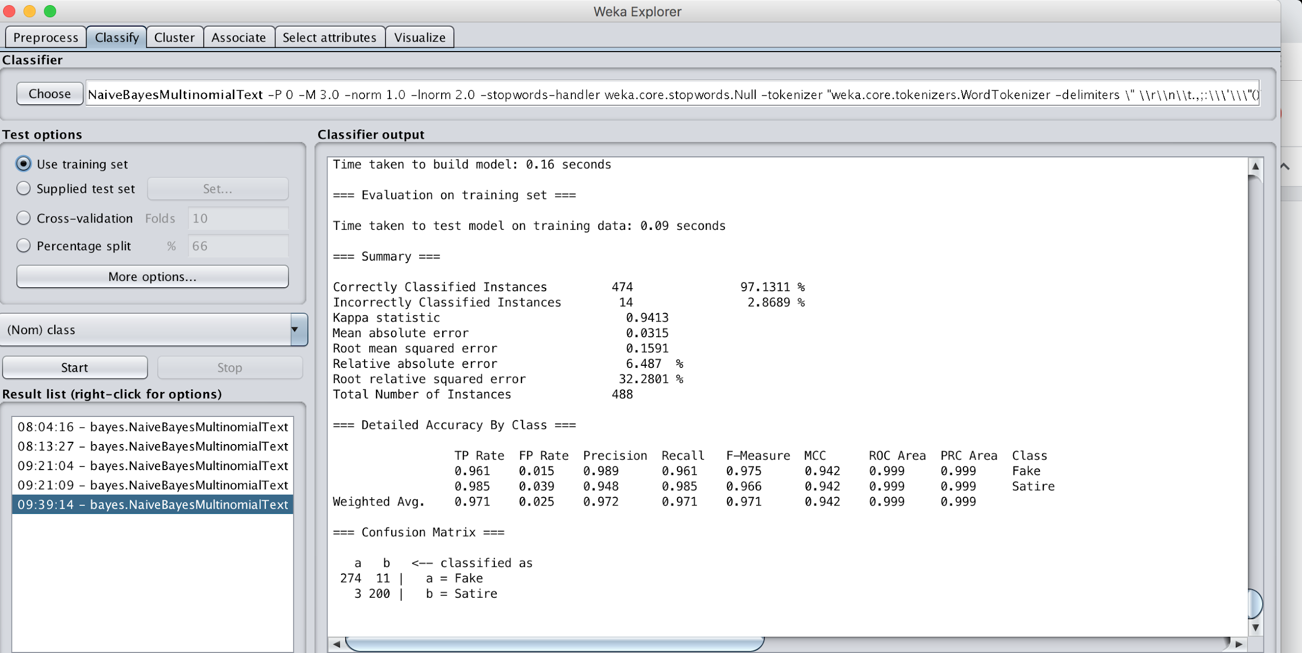
Training on Word Vector:
Source: WEKA

Slide 18
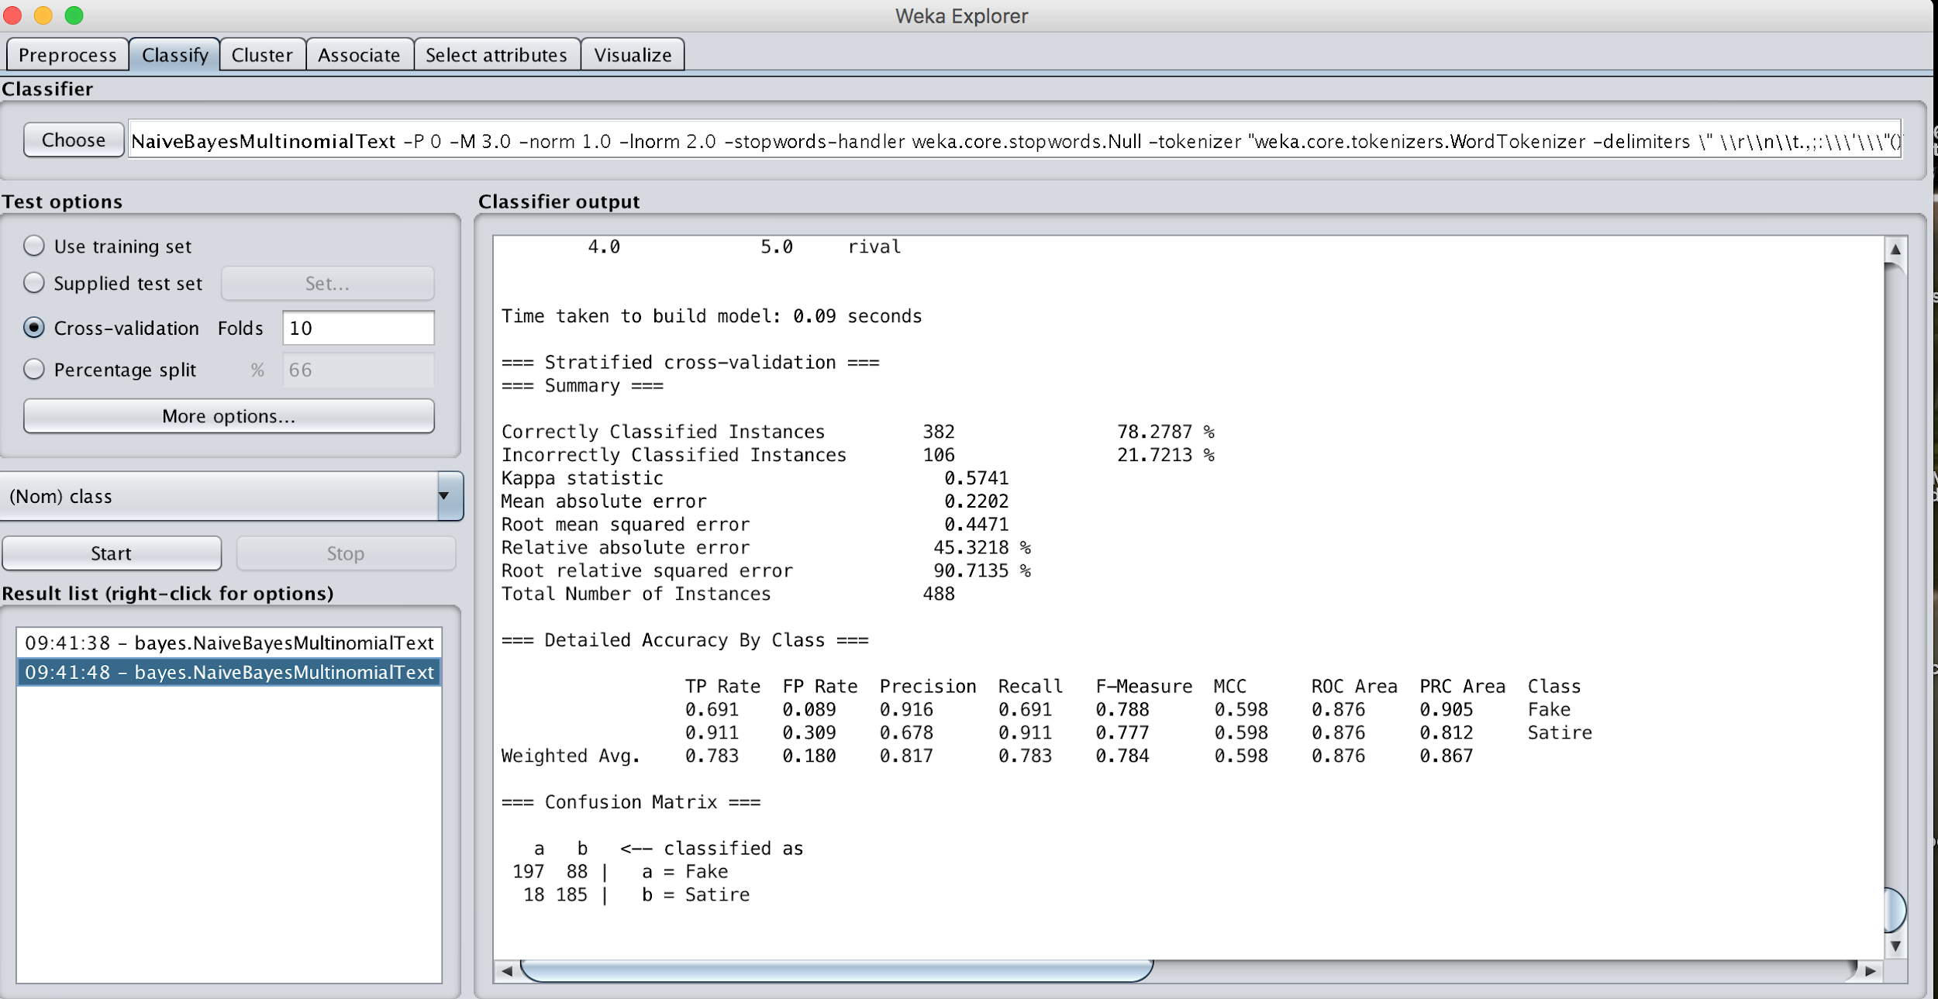
Testing: 10 fold Cross Validation
Source: WEKA

Slide 19
Thematic Analysis:
H - Hyperbolic position against one person or group (e.g. Trump, Clinton, Obama, Islam, refugees)
Example headline: “Obama Signs Executive Order Banning The Pledge of Allegiance In Schools Nationwide”
F - Hyperbolic position in favor of one person or group (e.g. Trump, Clinton, Obama, Islam, refugees)
“BECAUSE TRUMP WON THE PRESIDENCY, FORD SHIFTS TRUCK PRODUCTION FROM MEXICO TO OHIO!”
D - Discredit a normally credible source
“MIT Researchers: Global Warming Data Is Complete Bunk.”
Coded by: Jennifer Golbeck et al.,
http://web.stanford.edu/~mattm401/docs/2018-Golbeck-WebSci-FakeNewsVsSatire.pdf

Slide 20
Continued...
S - Sensationalist crimes and violence.
“George Zimmerman Found DEAD Just Hours After Bragging About Killing Trayvon Martin.”
R - Racist messaging.
“Trump Has Fired Muslim Sharia Judge Arrested And Charged.”
P - Paranormal theories (e.g. Aliens, Flat Earth)
“Donald Trump Says The Earth Is Flat.”
C - Conspiracy theories
“Hillary Clinton Busted in the Middle of Huge Pedophilia Ring Cover Up At State Department”
Coded by: Jennifer Golbeck et al.,
http://web.stanford.edu/~mattm401/docs/2018-Golbeck-WebSci-FakeNewsVsSatire.pdf

Slide 21
Continued...
Themes created mostly on the
1. Mechanism of sharing Fake News.
2. Content of the news.
Articles were labelled with above themes.
An article can be left with no theme applied or with multiple themes.
Coded by: Jennifer Golbeck et al.
http://web.stanford.edu/~mattm401/docs/2018-Golbeck-WebSci-FakeNewsVsSatire.pdf

Slide 22
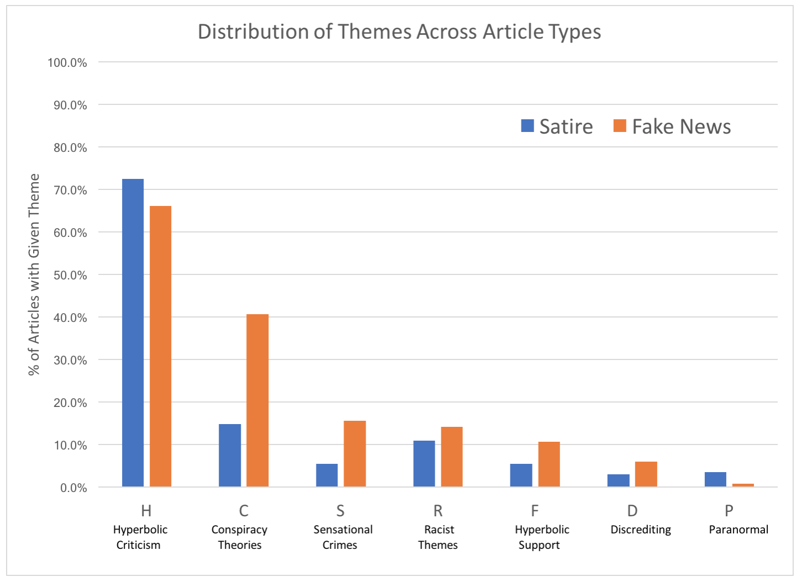
Theme Distribution Across Articles:
Source (Fig 2): http://web.stanford.edu/~mattm401/docs/2018-Golbeck-WebSci-FakeNewsVsSatire.pdf

Slide 23
Outcome:
Articles with multiple themes: 213 - 43.8%
Fake News: 157 - 55.5%
Satire: 56 - 27.6%
Common pair of themes appearing together:
Conspiracy Theory and Hyperbolic Criticism
Total Ratio: 19.5%.
Fake news articles: 26.9%
Satire: 9.4%
Title:
“President Obama Birth Certificate”
“Illegal Aliens cast 3 million votes”
“Murder of DNC staffer Seth Rich was orchestrated by George Soros”
http://web.stanford.edu/~mattm401/docs/2018-Golbeck-WebSci-FakeNewsVsSatire.pdf

Slide 24
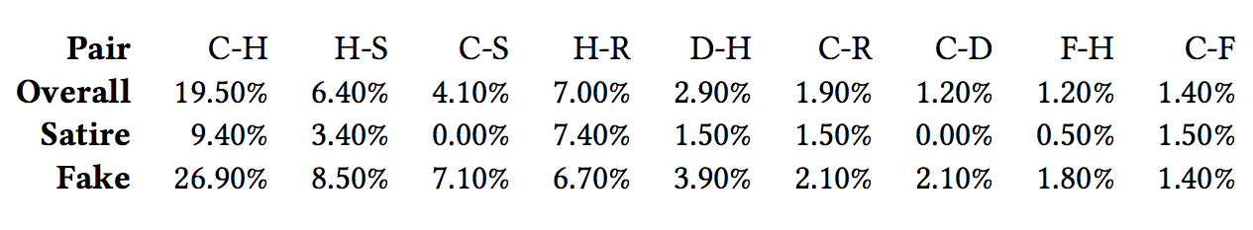
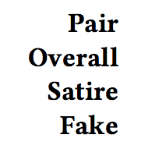
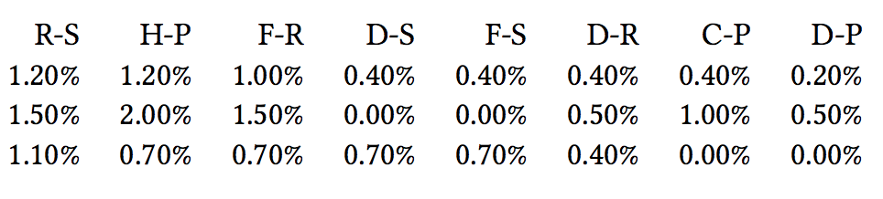
Distribution of Theme Pairs:
Source (Table 2): http://web.stanford.edu/~mattm401/docs/2018-Golbeck-WebSci-FakeNewsVsSatire.pdf

Slide 25
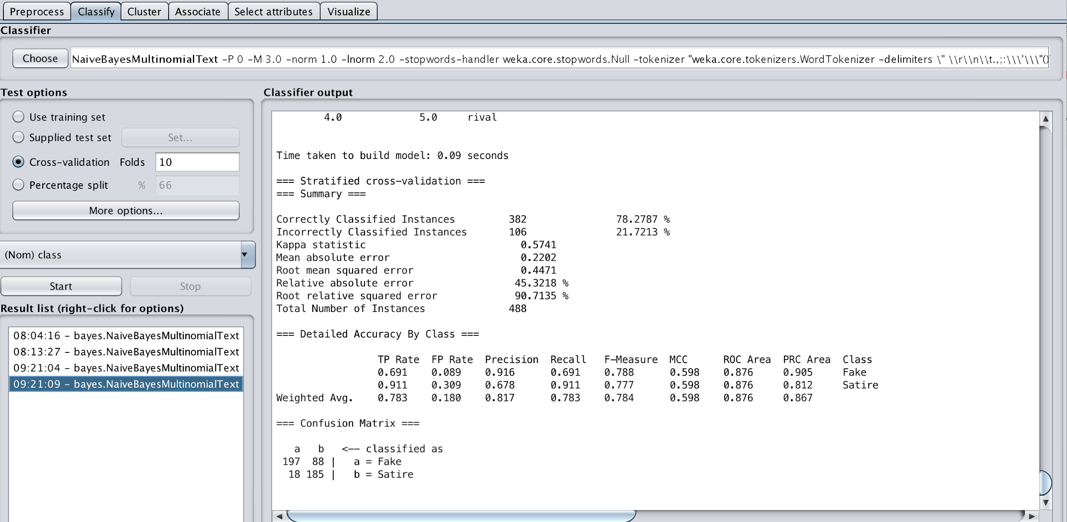
Themes and Word Vector Combination:

Slide 26
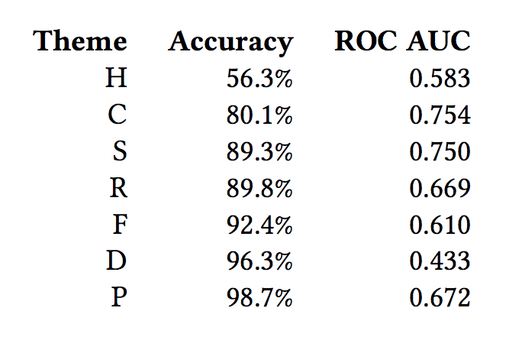
Detect Themes from Language:
Source (Table 3): http://web.stanford.edu/~mattm401/docs/2018-Golbeck-WebSci-FakeNewsVsSatire.pdf

Slide 27
Take Away:
Based on the handcrafted dataset and the preliminary analysis, it is possible to distinguish fake news and satire.
Conspiracy theories with Criticism and Sensational Crimes are more common in Fake news.
Paranormal themes are more common in Satire than Fake news.

